Slide 1
Tutorial Week 9 BERT for Image

Slide 2
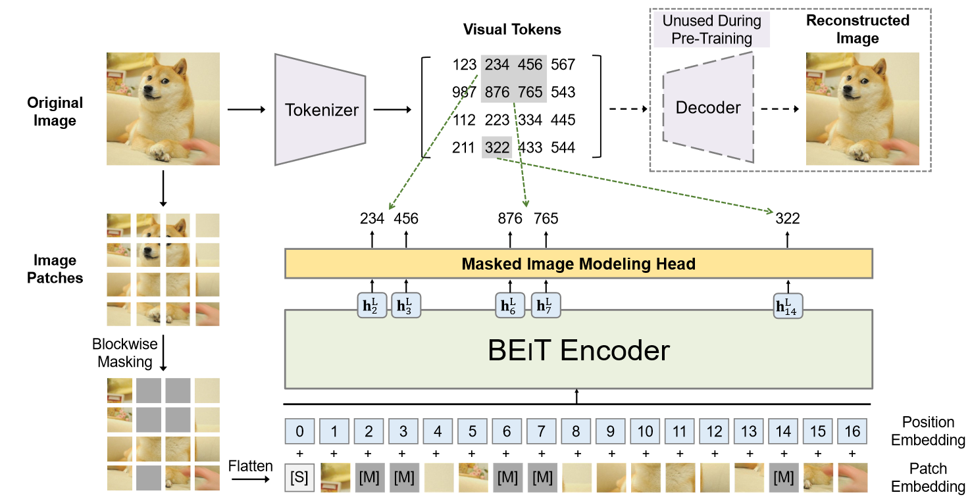
https://arxiv.org/abs/2106.08254

Slide 3
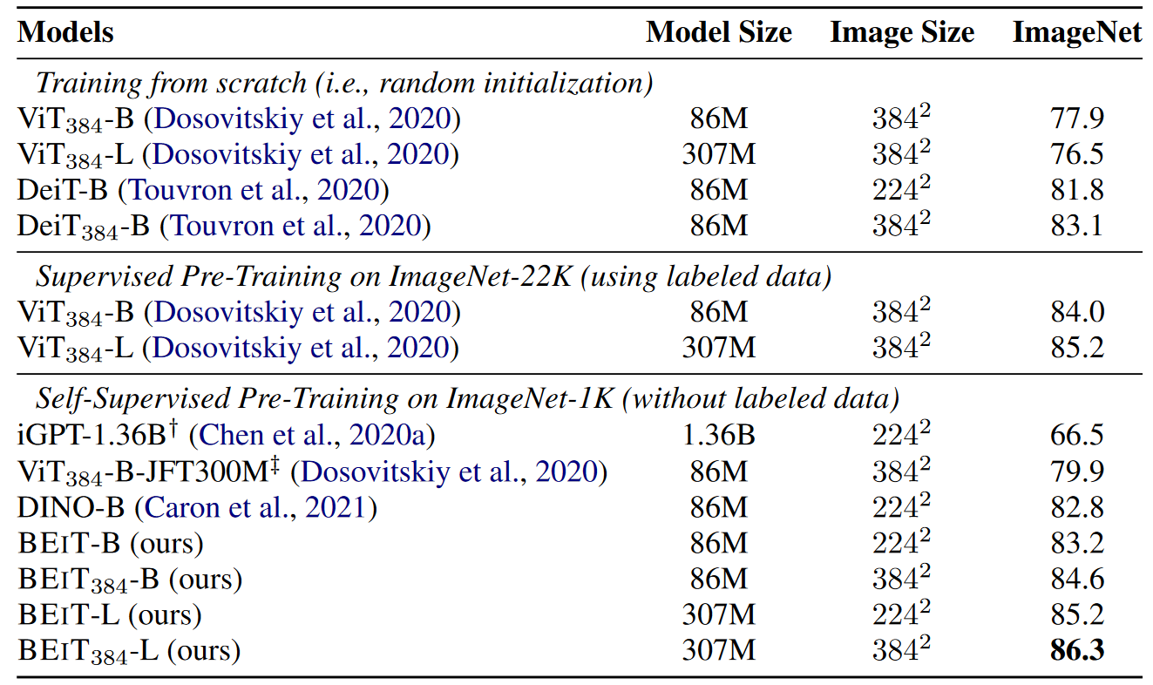
BEiT pretraining surpasses supervised training.

Slide 4
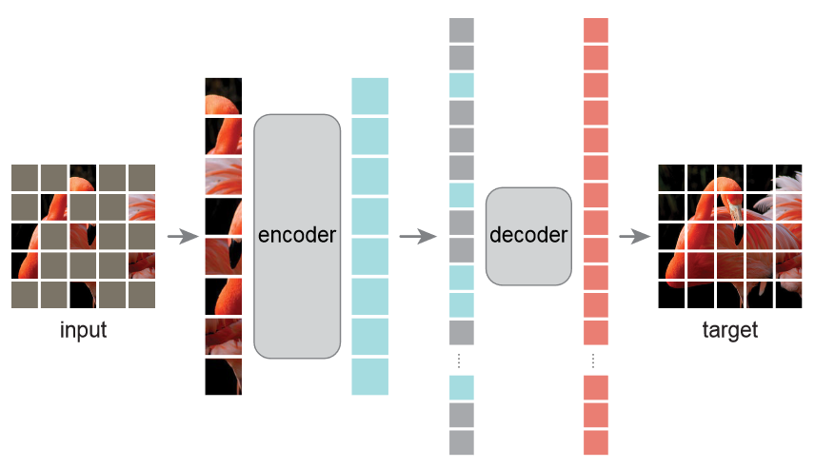
https://arxiv.org/abs/2111.06377

Slide 5
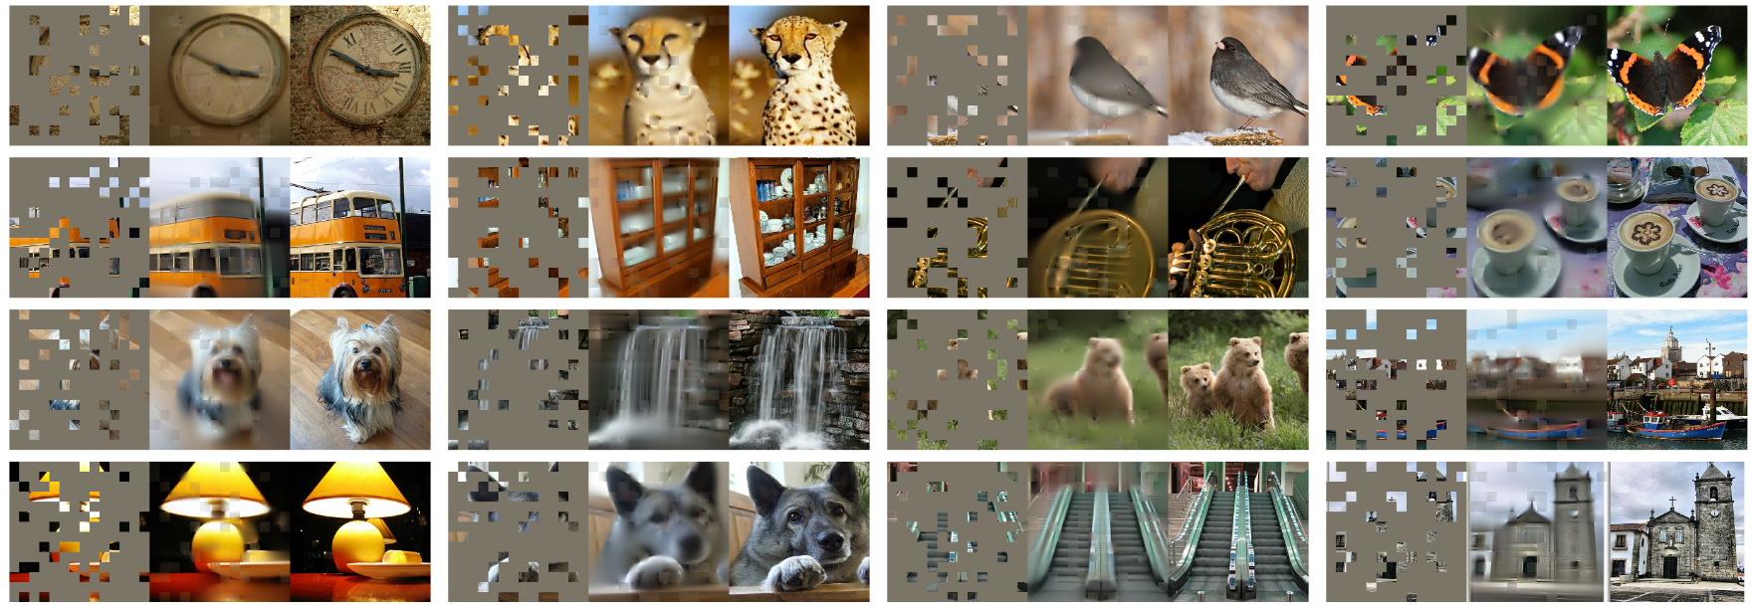

Slide 6
